Slide 1



DEPARTMENT OF COMPUTER SCIENCE & ENGINEERING
B.TECH VI SEM
PHP Programming

Slide 2
Capturing Form Data
The form's action attribute needs to contain the URL of the
PHP script that will handle the form.
For example:
<form action="form_handler.php"method="post">
When users send their forms, their data is sent to the server and the form_handler.php script is run.

Slide 3
Capturing Form Data
The PHP script needs following variables to read the form
data and perform the operations on it.
Superglobal Array | Description
$_GET | Contains a list of all the field names and values sent by a form using the get method
$_POST | Contains a list of all the field names and values sent by a form using the post method
$_REQUEST | Contains the values of both the $_GET and $_POST arrays combined, along with the values of the $_COOKIE superglobal array

Slide 4
PHP $_GET Variable
When to use method="get"?
The variable names and values will be visible in URL if HTML
forms submitted by the GET method.
The GET method is restricted to send up to 2048 characters only.
When you submit sensitive information like passwords then should
not use this method.
GET method can't be used, to send binary data like images and
Word documents.
GET method data can be accessed using PHP QUERY_STRING
environment variable.
PHP $_GET associative array is used to access all the sent
information by GET method.

Slide 5
PHP $_GET Variable
html>
<body>
<form action=“get.php"method="get">
<h1>$_GET Variable Example Program</h1>
Name: <input type="text" name="name">
</br>
Email: <input type="text" name="email">
<input type="submit">
</form>
</body>
</html>
get.html

Slide 6
PHP $_GET Variable
<html>
<body>
Welcome <?php echo $_GET["name"]; ?>
</br>
! Your email address is <?php echo $_GET["email"]; ?>
</body>
</html>
get.php

Slide 7
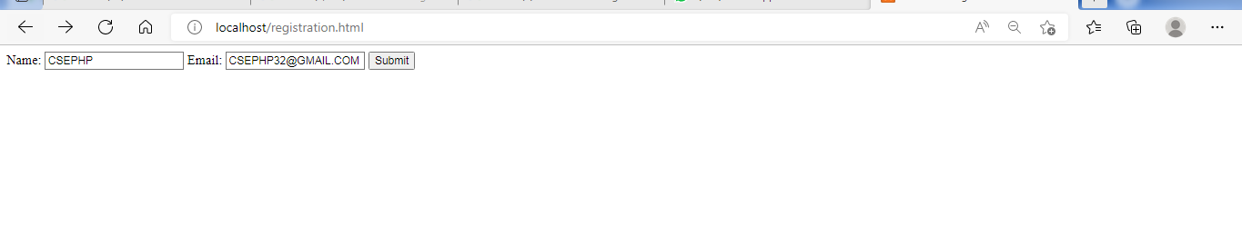
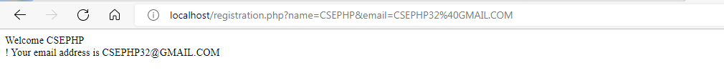
OUTPUT

Slide 8
PHP $_POST Variable
When to use method=“POST"?
The POST method does not have any restriction on data
size to be sent.
The POST method can be used to send ASCII as well as
binary data.
The data sent by POST method goes through HTTP
header, so security depends on HTTP protocol. By using
Secure HTTP, you can make sure that your information is
secure.
PHP $_POST associative array is used to access all the
sent information by POST method. Variables are not
visible in the URL so users can't bookmark your page.

Slide 9
PHP $_POST Variable
html>
<body> <center>
<form action=“post.php"method="post">
<h1>$_POST Variable Example Program</h1>
Name: <input type="text" name="name">
</br>
Email: <input type="text" name="email">
<input type="submit">
</form>
</body> </center>
</html>
post.html

Slide 10
PHP $_POST Variable
<html>
<body>
Welcome <?php echo $_POST["name"]; ?>
</br>
! Your email address is <?php echo $_POST["email"]; ?>
</body>
</html>
post.php

Slide 11
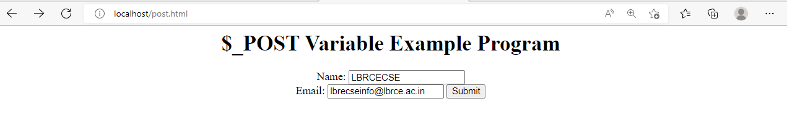

OUTPUT

Slide 12
PHP $_REQUEST Variable
The PHP $_REQUEST variable can be used to get the result from form data sent with both GET & POST methods.
<html>
<body>
Welcome <?php echo $_REQUEST["name"]; ?>!
Your email address is <?php echo $_REQUEST["Email"]; ?>
</body>
</html>

Slide 13
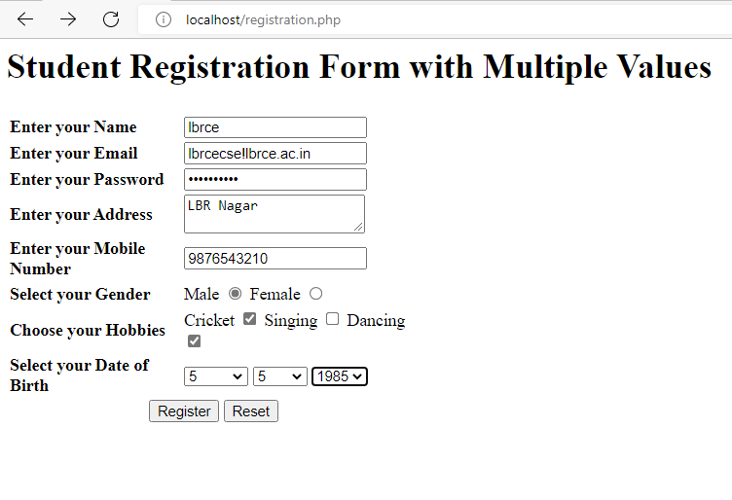
Dealing with Multi-value file

Slide 14
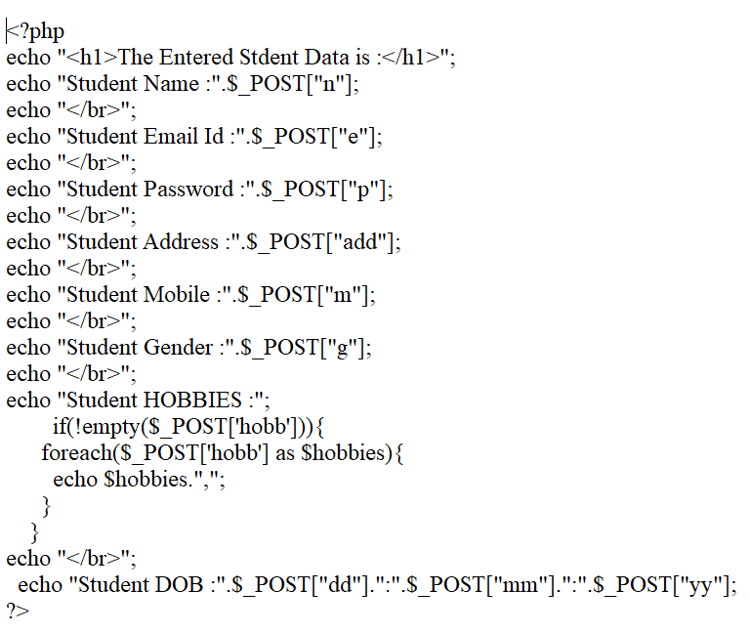
registration1.php

Slide 15
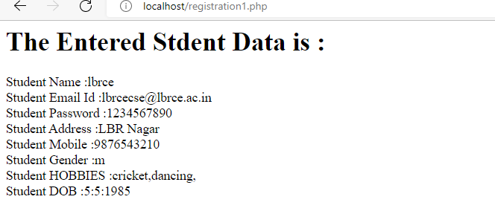
Dealing with Multi-value file

Slide 16
PHP File Upload
PHP allows us to upload single and multiple files through few lines of code only.
PHP file upload features allows us to upload binary and text files both. Moreover, you can have the full control over the file to be uploaded through PHP authentication and file operation functions.
PHP $_FILES
The PHP global $_FILES contains all the information of file. By the help of $_FILES global, we can get file name, file type, file size, temp file name and errors associated with file.

Slide 17
PHP File Upload
The following rules for the HTML form to upload file
<form action="upload.php" method="post" enctype="multipart/form-data">
Make sure that the form uses method="post"
The form also needs the following attribute: enctype="multipart/form-
data". It specifies which content-type to use when submitting the form
The type="file" attribute of the <input> tag shows the input field as a
file-select control, with a "Browse" button next to the input control.

Slide 18
PHP File Upload
move_uploaded_file() function
The move_uploaded_file() function moves the uploaded file to a new location. The move_uploaded_file() function checks internally if the file is uploaded thorough the POST request. It moves the file if it is uploaded through the POST request.
Syntax
bool move_uploaded_file ( string $filename , string $destination )

Slide 19
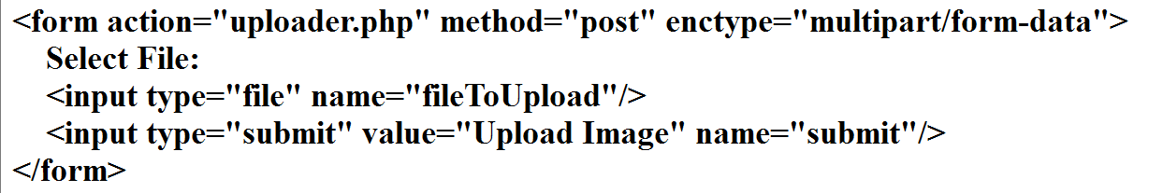
uploadform.html

Slide 20
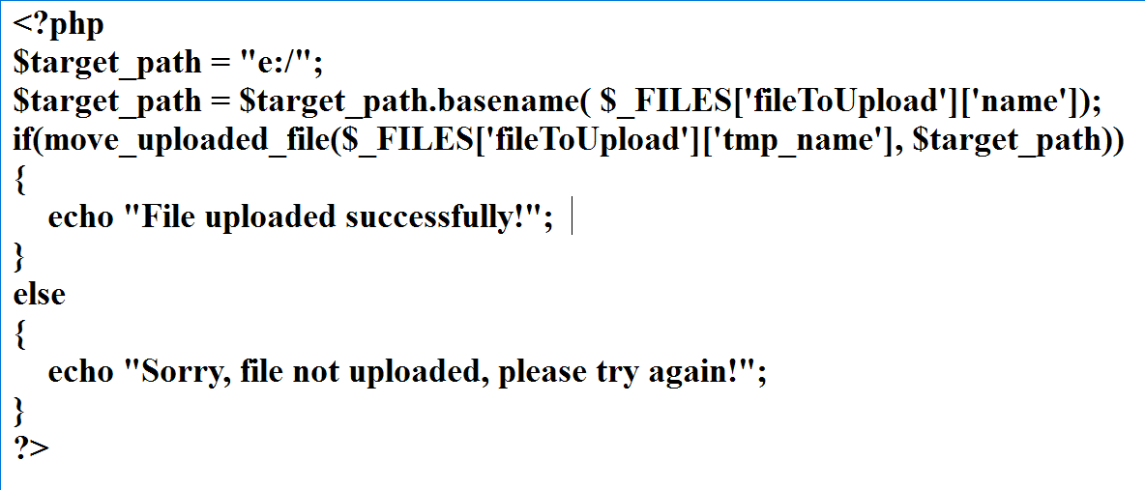
uploader.php

Slide 21
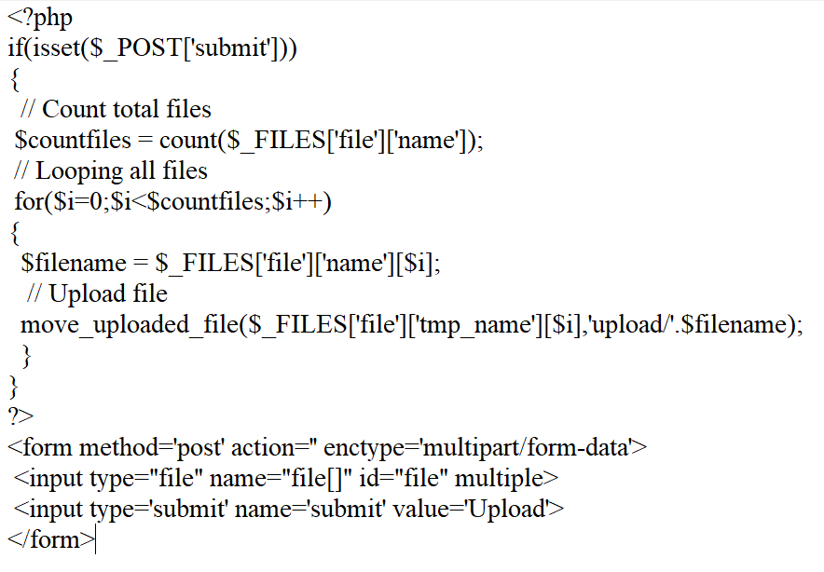
Multiple files upload at once with PHP

Slide 22
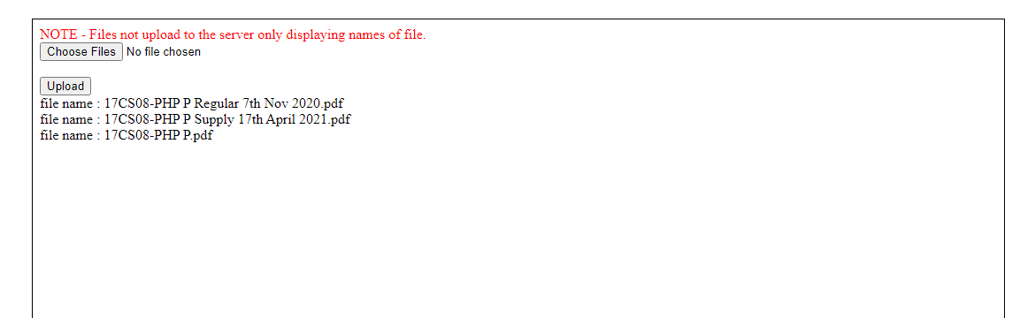
OUPUT

Slide 23
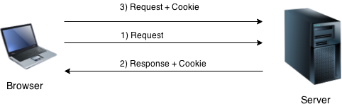
PHP Cookies
PHP cookie is a small piece of information which is stored at client browser. It is used to recognize the user.
Cookie is created at server side and saved to client browser. Each time when client sends request to the server, cookie is embedded with request. Such way, cookie can be received at the server side.

Slide 24
PHP Cookies
Create Cookies With PHP
PHP setcookie() function is used to set cookie with HTTP response.
Once cookie is set, you can access it by $_COOKIE super global variable.
Syntax
setcookie(name, value, expire, path, domain, secure, httponly);
Example:
setcookie("CookieName", "CookieValue");/* defining name and value only*/
setcookie("CookieName", "CookieValue", time()+1*60*60);//using expiry in 1 hour(1*60*60 seconds or 3600 seconds)
setcookie("CookieName", "CookieValue", time()+1*60*60, "/mypath/", "mydomain.com", 1);
PHP $_COOKIE:
$value=$_COOKIE["CookieName"];//returns cookie value

Slide 25
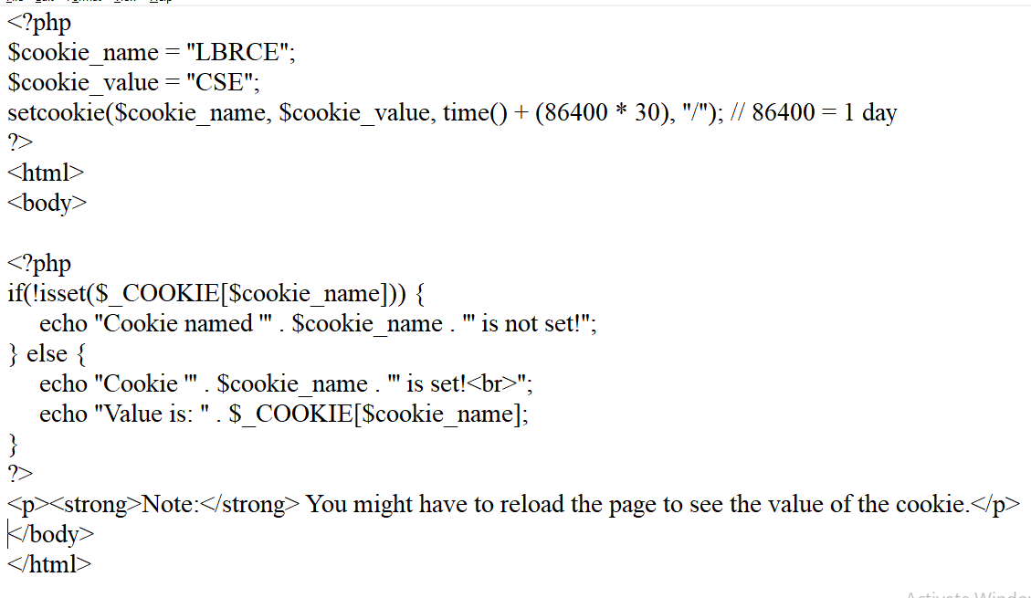
PHP Create/Retrieve a Cookie

Slide 26
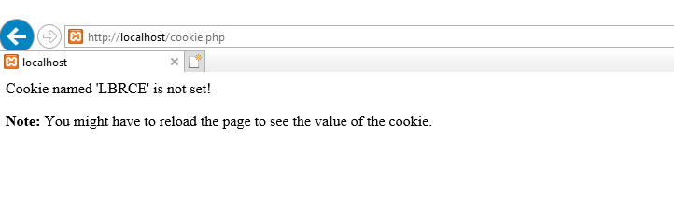
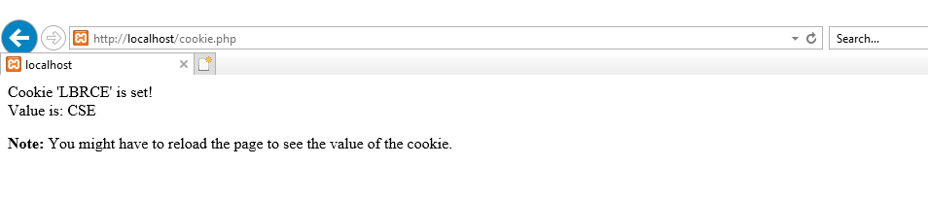
OUTPUT

Slide 27
PHP Session
PHP session is used to store and pass information from one page to another temporarily (until user close the website).
PHP session technique is widely used in shopping websites where we need to store and pass cart information e.g. username, product code, product name, product price etc from one page to another.
PHP session creates unique user id for each browser to recognize the user and avoid conflict between multiple browsers.

Slide 28
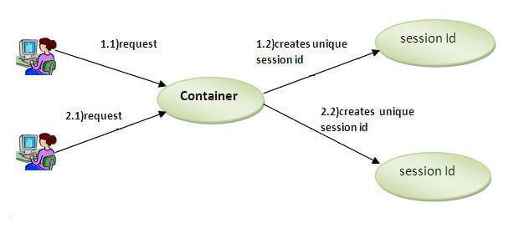
PHP Session

Slide 29
PHP Session
PHP session_start() function
PHP session_start() function is used to start the session. It starts a new or resumes existing session. It returns existing session if session is created already. If session is not available, it creates and returns new session.
Syntax
bool session_start ( void )
Example
session_start();
PHP $_SESSION
PHP $_SESSION is an associative array that contains all session variables. It is used to set and get session variable values.
Example: Store information
$_SESSION["user"] = “LBRCE";
Example: Get information
echo $_SESSION["user"];

Slide 30
PHP Session
<?php
session_start();
?>
<html>
<body>
<?php
$_SESSION["user"] = "LBRCE";
echo "Session information are set successfully.<br/>";
?>
<a href="session2.php">Visit next page</a>
</body>
</html>
session1.php

Slide 31
PHP Session
<?php
session_start();
?>
<html>
<body>
<?php
echo "User is: ".$_SESSION["user"];
?>
</body>
</html>
session2.php

Slide 32
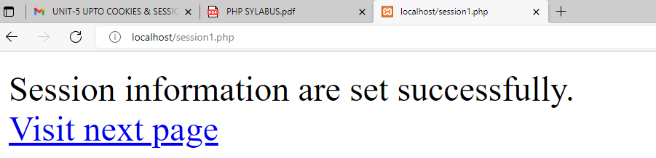
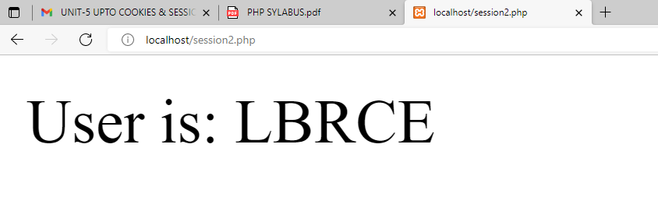
PHP Session-OUTPUT

Slide 33
PHP Session
sessioncounter.php
<?php
session_start();
if (!isset($_SESSION['counter'])) {
$_SESSION['counter'] = 1;
} else {
$_SESSION['counter']++;
}
echo ("Page Views: ".$_SESSION['counter']);
?>

Slide 34
PHP Session
<?php
session_start();
if (!isset($_SESSION['counter']))
{
$_SESSION['counter'] = 1;
}
else
{
$_SESSION['counter']++;
}
echo ("Page Views: ".$_SESSION['counter']);
?>
sessioncounter.php

Slide 35
PHP Session
<?php
session_start();
session_destroy();
?>
sessiondestroy.php

Slide 36
PHP HTTP header()
The PHP HTTP header() functions sends a raw HTTP header.
This function returns no value.
The HTTP header( ) function was introduced in 4.3.0
Syntax:
void header ( string $string [, bool $replace = true [, int $http_response_code ]] );
Parameter | Description | Is compulsory
string | It specifies the header string to send. | compulsory
replace | It indicates whether the header should replace the previous header or add a second header. | Optional
http_response_code | It forces the HTTP response code to the specified value. | Optional

Slide 37
PHP HTTP header()
Example 1
<?php
header("Location: https://www.google.com/");
?>
Example 2
<?php
$redirect_page='https://www.google.com/';
$redirect= false;
header('Location:'.$redirect_page);
?>

Slide 38
PHP HTTP header()
Example 3.php
<?php
if($test)
{
echo "You're in!";
}
else
{
header('Location: https://www.lbrce.ac.in/');
}
?>

Slide 39
PHP MySQL Database
MySQL is the most popular database system used with PHP
What is MySQL?
  MySQL is a database system used on the web
  MySQL is a database system that runs on a server
  MySQL is ideal for both small and large applications
  MySQL is very fast, reliable, and easy to use
  MySQL uses standard SQL
  MySQL compiles on a number of platforms
  MySQL is free to download and use
  MySQL is developed, distributed, and supported by Oracle Corporation

Slide 40
PHP Connect to MySQL
MySQL database:
  MySQLi extension (the "i" stands for improved)
  PDO (PHP Data Objects)
The following three ways of working with PHP and MySQL:
  MySQLi (object-oriented)
  MySQLi (procedural)
  PDO

Slide 41
MySQLi (object-oriented)
MySQLi stands for "MySQL Improved."
It's an object-oriented extension introduced in PHP 5.0 as an improvement over the original MySQL extension.
Supports prepared statements (precompiled SQL statements) for increased security and performance.
Provides support for transactions, stored procedures, and multiple statements.
Utilizes an object-oriented approach, meaning you work with MySQLi objects and methods.

Slide 42
MySQLi (object-oriented)
Example:
<?php
$servername = "localhost";
$username = "root";
$password = "";
// Create connection
$conn = new mysqli($servername, $username, $password);
if ($conn->connect_error) // Check connection
{
die("Connection failed: " . $conn->connect_error);
}
echo "Connected successfully";
$conn->close();
?>

Slide 43
MySQLi (Procedural):
Similar to the object-oriented style, but uses procedural functions instead of objects and methods.
Designed for developers who prefer a more procedural programming style.
Offers similar features as the object-oriented style but accessed through procedural functions.

Slide 44
MySQLi (Procedural):
<?php
$servername = "localhost";
$username = "root";
$password = "";
// Create connection
$conn = mysqli_connect($servername, $username, $password);
if (!$conn) // Check connection
{
die("Connection failed: " . mysqli_connect_error());
}
echo "Connected successfully";
mysqli_close($conn);
?>

Slide 45
PDO (PHP Data Objects):
PDO is a database access abstraction layer that provides a uniform interface for accessing multiple databases.
Supports various database systems, not limited to MySQL.
PDO is not specific to MySQL but provides a common interface for accessing databases, making it more portable.
Supports prepared statements and parameterized queries for enhanced security.
PDO is often favored for its portability and consistency across different database systems.

Slide 46
PDO (PHP Data Objects):
<?php
$servername = "localhost";
$username = "root";
$password = "";
try {
$conn = new PDO("mysql:host=$servername;dbname=myDB", $username,
$password);
// set the PDO error mode to exception
$conn->setAttribute(PDO::ATTR_ERRMODE, PDO::ERRMODE_EXCEPTION);
echo "Connected successfully";
}
catch(PDOException $e)
{
echo "Connection failed: " . $e->getMessage();
}
$conn = null;
?>

Slide 47
Comparison:
Feature | MySQLi (Object-Oriented) | MySQLi (Procedural) | PDO (PHP Data Objects)
Style | Object-oriented | Procedural | Object-oriented
Error Handling | Object-oriented (via exceptions) | Procedural (via error functions) | Object-oriented (via exceptions)
Prepared Statements | Yes | Yes | Yes
Transaction Support | Yes | Yes | Yes
Multiple Statements | Yes | Yes | Yes
Portability | Limited to MySQL | Limited to MySQL | Supports multiple databases
Code Readability | Generally clearer and more concise | Can be verbose | Generally clearer and more concise
Performance | Similar | Similar | Similar
Security | Prepared statements help prevent SQL injection | Prepared statements help prevent SQL injection | Prepared statements help prevent SQL injection

Slide 48
Database Connectivity with MySQL
Start MySQL Server
Connection with MySQL Database
1. Open a Connection to MySQL
Create a MySQL Database
Create a MySQL Table
Performing basic database operations
(DML) (Insert, Delete, Update, Select)

Slide 49
Connection with MySQL Database
Open a Connection to MySQL
mydb1.php
<?php
$servername = "localhost"; //local server name default localhost
$username ="root"; //mysql username default is root.
$password = ""; //blank if no password is set for mysql.
// Create connection
$conn = mysqli_connect($servername, $username, $password);
// Check connection
if (!$conn)
{
die("Connection failed:" . mysqli_connect_error());
}
echo “<h1>Connected successfully</h1>";
?>

Slide 50
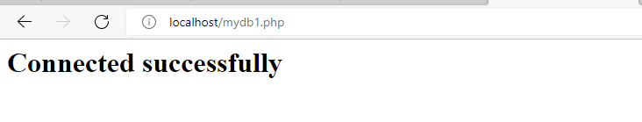
Create a MySQL Database
OUTPUT

Slide 51
Create a MySQL Database
mydb2.php
<?php
$servername = "localhost"; //local server name default localhost
$username ="root"; //mysql username default is root.
$password = ""; //blank if no password is set for mysql.
// Create connection
$conn = mysqli_connect($servername, $username, $password);
// Check connection
if (!$conn)
{
die("Connection failed: " . mysqli_connect_error());
}
Cont….

Slide 52
Create a MySQL Database
// Create database
$sql = "CREATE DATABASE LBRCE";
if (mysqli_query($conn, $sql))
{
echo "<h1><center>Database created successfully</center></h1>";
}
else
{
echo "Error creating database" . mysqli_error($conn);
}
mysqli_close($conn);
?>

Slide 53
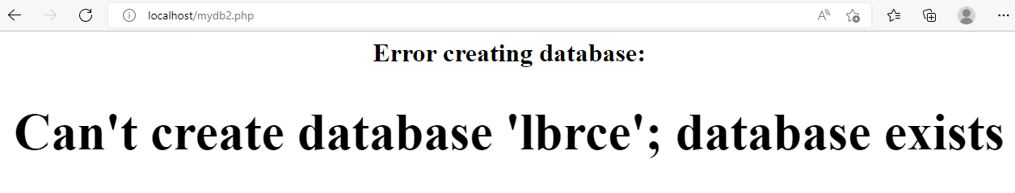
Create a MySQL Database
OUTPUT

Slide 54
Create a MySQL Table
Create “LOGIN” table:
SQL>CREATE TABLE login(uname VARCHAR(15)
PRIMARY KEY, password VARCHAR(15) NOT NULL,
emailid VARCHAR (20) NOT NULL,
mobile INT(10) UNIQUE);

Slide 55
Create a MySQL Table
mydb3.php
<?php
$servername = "localhost"; //local server name default localhost
$username ="root"; //mysql username default is root.
$password = ""; //blank if no password is set for mysql.
$dbname = "lbrce"; //database name which you created
// Create connection
$conn = mysqli_connect($servername, $username, $password, $dbname);
// Check connection
if (!$conn)
{
die("Connection failed: " . mysqli_connect_error());
}
Cont….

Slide 56
Create a MySQL Table
// sql to create table
$sql = "CREATE TABLE login(uname VARCHAR(15) PRIMARY KEY,password VARCHAR(15) NOT NULL, emailid VARCHAR (20), mobile INT(10) UNIQUE)";
if (mysqli_query($conn, $sql))
{
echo "<center><h1>Table login created successfully</center></h1>";
}
else
{
echo "Error creating table: " . mysqli_error($conn);
}
mysqli_close($conn);
?>
mydb3.php

Slide 57
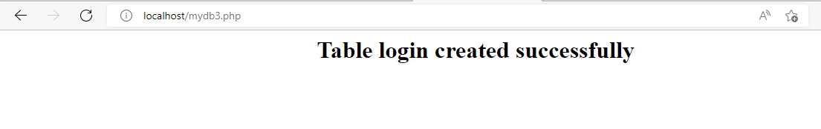

Create a MySQL Table
OUTPUT

Slide 58
Performing basic database operations
(DML) (Insert, Delete, Update, Select)
mydb4.php
<?php
$servername = "localhost"; //local server name default localhost
$username ="root"; //mysql username default is root.
$password = ""; //blank if no password is set for mysql.
$dbname = "lbrce"; //database name which you created
// Create connection
$conn = mysqli_connect($servername, $username, $password, $dbname);
// Check connection
if (!$conn)
{
die("Connection failed: " . mysqli_connect_error());
}
Cont….

Slide 59
Performing basic database operations
(DML) (Insert, Delete, Update, Select)
Insert
$sql = "INSERT INTO login (uname,password,emailid, mobile)VALUES('lbrce','cse@1234','lbrcecse@lbrce.ac.in',9876543210)";
if (mysqli_query($conn, $sql))
{
echo "<center><h1>New record created successfully </center></h1>";
} else
{
echo "Error: " . $sql . "<br>" . mysqli_error($conn);
}
mysqli_close($conn);
?>

Slide 60

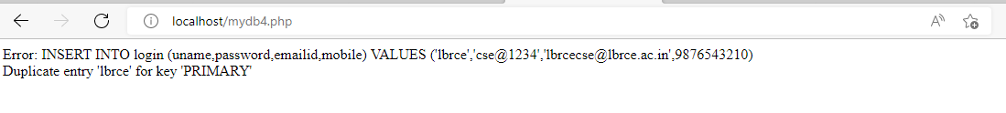
Performing basic database operations
(DML) (Insert, Delete, Update, Select)
OUTPUT
Insert

Slide 61
Performing basic database operations
(DML) (Insert, Delete, Update, Select)
mydb6.php
<?php
$servername = "localhost"; //local server name default localhost
$username ="root"; //mysql username default is root.
$password = ""; //blank if no password is set for mysql.
$dbname = "lbrce"; //database name which you created
// Create connection
$conn = mysqli_connect($servername, $username, $password, $dbname);
// Check connection
if (!$conn)
{
die("Connection failed: " . mysqli_connect_error());
}
Cont….

Slide 62
Performing basic database operations
(DML) (Insert, Delete, Update, Select)
$sql = "SELECT uname,emailid,mobile FROM login";
$result = mysqli_query($conn, $sql);
if (mysqli_num_rows($result) > 0)
{
// output data of each row
while($row = mysqli_fetch_assoc($result))
{
echo "User Name: " . $row["uname"]. " - Email ID: " . $row["emailid"]. "-Mobile No: " . $row["mobile"]. "<br>";
}}
else
{ echo "0 results";
}mysqli_close($conn);?>
mydb6.php
Cont….

Slide 63
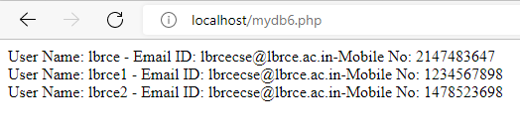
Performing basic database operations
(DML) (Insert, Delete, Update, Select)
OUTPUT
mydb6.php

Slide 64
Performing basic database operations
(DML) (Insert, Delete, Update, Select)
mydb7.php
<?php
$servername = "localhost"; //local server name default localhost
$username ="root"; //mysql username default is root.
$password = ""; //blank if no password is set for mysql.
$dbname = "lbrce"; //database name which you created
// Create connection
$conn = mysqli_connect($servername, $username, $password, $dbname);
// Check connection
if (!$conn)
{
die("Connection failed: " . mysqli_connect_error());
}
Cont….

Slide 65
Performing basic database operations
(DML) (Insert, Delete, Update, Select)
$sql = "UPDATE login SET emailid='lbrcecse@gmail.com' WHERE uname='lbrce'";
if ($conn->query($sql) === TRUE)
{
echo "<center><h1>Record updated successfully</center></h1>";
}
else
{
echo "Error updating record: " . $conn->error;
}
mysqli_close($conn);
?>
mydb7.php
Cont….

Slide 66

Performing basic database operations
(DML) (Insert, Delete, Update, Select)
OUTPUT
mydb7.php
Cont….

Slide 67
Performing basic database operations
(DML) (Insert, Delete, Update, Select)
mydb8.php
<?php
$servername = "localhost"; //local server name default localhost
$username ="root"; //mysql username default is root.
$password = ""; //blank if no password is set for mysql.
$dbname = "lbrce"; //database name which you created
// Create connection
$conn = mysqli_connect($servername, $username, $password, $dbname);
// Check connection
if (!$conn)
{
die("Connection failed: " . mysqli_connect_error());
}
Cont….

Slide 68
Performing basic database operations
(DML) (Insert, Delete, Update, Select)
mydb8.php
// sql to delete a record
$sql = "DELETE FROM login WHERE uname='lbrce'";
if (mysqli_query($conn, $sql))
{
echo "Record deleted successfully";
} else
{
echo "Error deleting record: " . mysqli_error($conn);
}
mysqli_close($conn);
?>
Cont….

Slide 69
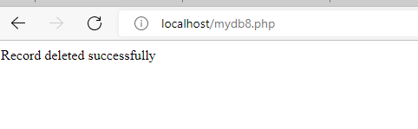
Performing basic database operations
(DML) (Insert, Delete, Update, Select)
OUTPUT
mydb8.php
Cont….

